Slide 1


Review of the National Agreement on Closing the Gap
Final Report
OFFICIAL
Webinar
29 February 2024
Romlie Mokak, Commissioner
Natalie Siegel-Brown, Commissioner

Slide 2
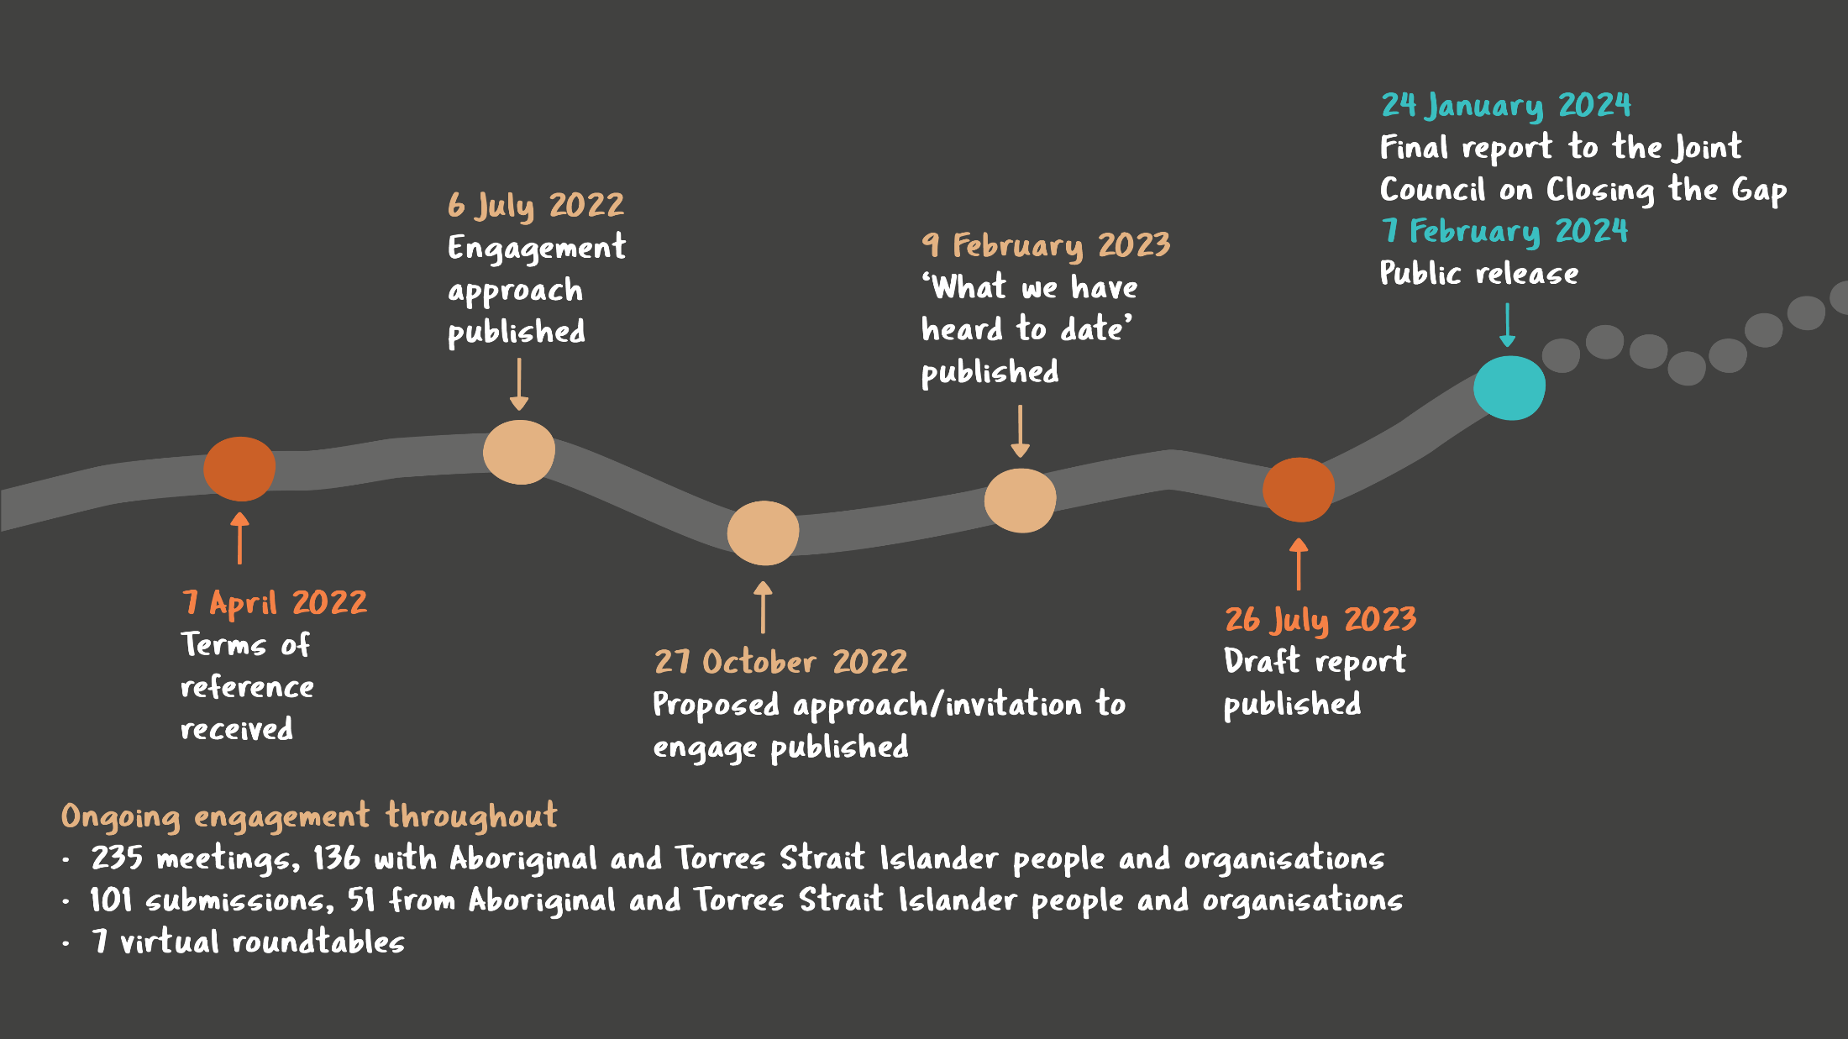
How we got here
OFFICIAL
National Agreement on Closing the Gap Review Final Report

Slide 3



Overall assessment – insufficient progress
  The commitment to shared decision making is rarely achieved in practice
  Government policy doesn’t reflect the value of the community-controlled sector
  The transformation of government organisations has barely begun
  Governments are not enabling Aboriginal and Torres Strait Islander led data
  Performance reporting provides only a partial picture of progress
  Accountability for delivering on the commitments in the Agreement is lacking
National Agreement on Closing the Gap Review Final Report

Slide 4
To achieve change, the Commission is making four thematic recommendations, each with specific actions
Power needs to be shared
Indigenous Data Sovereignty needs to be recognised and supported
Mainstream systems and culture need to be fundamentally rethought
Stronger accountability is needed to drive behaviour change
National Agreement on Closing the Gap Review Final Report

Slide 5

Recommendation 1
Power needs to be shared
Some partnerships arrangements have succeeded in building trust and progressing the priorities of communities
But others have done little to bridge mistrust, and most have fallen short of embedding shared decision making in a sustained way
Governments need to trust that relinquishing control over decisions will enable better outcomes for Aboriginal and Torres Strait Islander people
National Agreement on Closing the Gap Review Final Report

Slide 6
Recommendation 1
Power needs to be shared
  Amend the Agreement to clarify that Priority Reform 1’s purpose is self-determination and its scope is broader than policy and place-based partnerships (action 1.1)
  Treat ACCOs as essential partners in program and service design and delivery, not simply as funding recipients (action 1.2)
  Ensure there are regular meetings between Ministers and Aboriginal and Torres Strait Islander peak bodies only (action 1.3)
  Adequately resource Aboriginal and Torres Strait Islander participation in implementation, as well as actions by government organisations to implement the Agreement and its accountability mechanisms (action 1.4)
  Treat implementation plans as strategic documents containing a theory of change, not laundry lists. Work closely with Aboriginal and Torres Strait Islander partners to agree strategies and actions that are substantiative and critical to achieving the objectives of the Agreement (action 1.5)

Slide 7
Recommendation 2
Indigenous Data Sovereignty needs to be recognised and supported
Sharing existing data with Aboriginal and Torres Strait Islander communities is a necessary but not sufficient for shared decision-making
While the commitments under Priority Reform 4 relate to some aspects of IDS, they do not reflect all of the key principles of IDS
National Agreement on Closing the Gap Review Final Report

Slide 8
Recommendation 2
Indigenous Data Sovereignty needs to be recognised and supported
  Amend the Agreement to explicitly include IDS as part of the outcome statement for Priority Reform 4 (action 2.1)
  This should be accompanied by other changes, including adopting the definitions of IDS and IDG set out by the Maiam nayri Wingara Indigenous Data Sovereignty Collective and governments committing to partnering with Aboriginal and Torres Strait Islander organisations and communities to embed IDG
  Establish a Bureau of Indigenous Data (action 2.2) to support governments to embed IDG into their data systems and practices, invest in the data capability of Aboriginal and Torres Strait Islander organisations and communities, and consolidate and oversee the data development work under the Agreement
National Agreement on Closing the Gap Review Final Report

Slide 9
Recommendation 3
Mainstream systems and culture need to be fundamentally rethought
Governments have not fully grasped the scale of change required to their systems, culture, operations and ways of working to deliver the unprecedented shift they have committed to in the Agreement
Without fundamental changes, the objective of the Agreement is unlikely to be achieved
National Agreement on Closing the Gap Review Final Report

Slide 10
Recommendation 3
Mainstream systems and culture need to be fundamentally rethought
  Government departments need to develop and execute a transformation strategy for their portfolio (action 3.1)
  Ensure funding and contracting rules explicitly incorporate accountability for funders to abide by the Priority Reforms in commissioning processes (action 3.2)
  Review and update Cabinet and Budget processes so that they explicitly promote, support and encourage the Priority Reforms (action 3.3)
  Designate a senior leadership group to drive public sector change in each jurisdiction (action 3.4)
  Embed responsibility for improving cultural capability and relationships with Aboriginal and Torres Strait Islander people into public sector employment requirements (action 3.5)
National Agreement on Closing the Gap Review Final Report

Slide 11
Recommendation 4
Stronger accountability is needed to drive behaviour change
Despite the range of accountability mechanisms in the Agreement, they are not sufficient to influence the type of change envisaged in the Agreement
They are not sufficiently independent, do not contain timely and appropriate consequences for failure, obscure the individual responsibilities of each party and are not informed by high-quality evaluation
National Agreement on Closing the Gap Review Final Report

Slide 12
Recommendation 4
Stronger accountability is needed to drive behaviour change
  Establish the independent mechanism in each jurisdiction without further delay (action 4.1)
  Embed the National Agreement on Closing the Gap in other intergovernmental Agreements (action 4.2)
  Include a statement on Closing the Gap in every government organisation’s annual report, detailing substantive actions taken and the outcome of those actions (action 4.3)
  Publish the stocktakes, partnership agreements, transformation strategies and other documents developed under the Agreement (action 4.4)
National Agreement on Closing the Gap Review Final Report

Slide 13





Review of the National Agreement on Closing the Gap
Final Report
ctg.review@pc.gov.au
@productivitycommission
@ozprodcom
@productivity-commission

